Slide 1

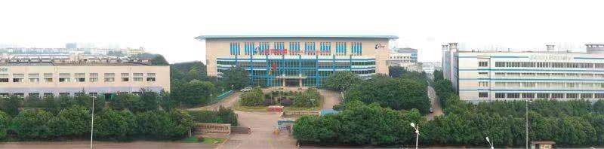
Current Status of the Rapidly Quenched NdFeB Magnetic Powder Industry
Chengdu Galaxy Magnets Co., Ltd.
General Manager Zhijian Wu

Slide 2
Main Contents
Industry Background
Industry Capacity and Market Structure
Production Equipment and Manufacturing Status
Core Process Optimization
Trend of Magnetic Powder Production Cost Changes
Diversification of Magnetic Powder Grades
Competition and Development in the Magnetic Powder Market

Slide 3
1. Industry Background
In the early 1980s, Satoru Sasaki from Sumitomo Special Metals and J.J. Croat from General Motors almost simultaneously discovered the third-generation rare-earth permanent magnet material—neodymium iron boron (NdFeB).
Sumitomo Metal chose the powder metallurgy approach, using traditional sintering to produce anisotropic dense magnets, which are the sintered NdFeB we are familiar with.
General Motors opted for rapid quenching technology, spraying molten alloys onto a high-speed rotating cooling roller to rapidly cool and prepare amorphous or nanocrystalline structures of fast-quenched magnetic powder. Subsequently, General Motors established Magnequench, a company dedicated to the commercialization of rapidly quenched NdFeB magnetic powder.

Slide 4
1. Industry Background
1. Industry Background
Applications of Fast Quenching NdFeB Magnetic Powder
Rapidly quenched NdFeB magnetic powder was almost simultaneously applied in the production of bonded NdFeB magnets and hot-pressed NdFeB magnets, with the majority being used for bonded NdFeB magnets.
Bonded NdFeB magnets are primarily formed through methods such as pressing, injection molding, and extrusion. Among these, pressing is currently the dominant forming method, accounting for approximately 85% of the total bonded NdFeB magnet production. Injection molding has also seen rapid growth in recent years.

Slide 5
1. Industry Background
1. Industry Background
1. Industry Background
Applications of Fast Quenching NdFeB Magnetic Powder
Hot-pressed NdFeB magnets are mainly formed through hot extrusion. Compared to sintered NdFeB magnets, they offer lower cost-effectiveness, and the current market size is relatively small. Major manufacturers include Daito (Japan), Chengdu Galaxy Magnetics, and Ningbo Jinji.

Slide 6
1. Industry Background
In the early 1990s, some universities and research institutions in China entered the field of bonded magnets to conduct research and development. Later, a few companies, such as Chengdu Galaxy Magnets, began small-scale trial production and manufacturing.
At that time, there were two main sources for obtaining magnetic powder for bonded magnets:
  One was importing rapidly quenching magnetic powder from the U.S. Magnequench Company, which offered magnetic powders with high, medium, and low performance levels;
  The other was domestically produced medium and low performance fast quenching magnetic powder by a few companies using arc furnaces.

Slide 7
2. Industry Capacity and Market Structure
Currently, there are approximately 14 manufacturers of magnetic powder, and it is reported that 1-2 more will be added in the near future.
No. | Company Name | Provinces
1 | Magnequench (Tianjin) Co., Ltd. | Tianjin
2 | Chengdu Galaxy Magnets Co., Ltd. | Sichuan
3 | Dongyang Silver Sea Magnetics Co., Ltd. | Zhejiang
4 | Baotou Kecrui Micromagnetic New Materials Co., Ltd. | Inner Mongolia
5 | Yuyan Rare Earth High-Tech Co., Ltd. | Hebei
6 | Jiangxi Jiangwu Rare Metal New Materials Co., Ltd. | Jiangxi
7 | Beijing Sanjili New Materials Co., Ltd. | Beijing
8 | Sichuan Huiling Technology Co., Ltd. | Sichuan
9 | Tianjin Jinhai Magnetics Co., Ltd. | Tianjin
… | … | …
Distribution of Rapidly Quenching Magnetic Powder Manufacturers

Slide 8
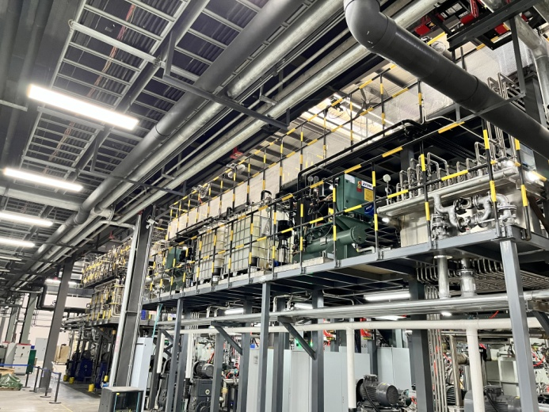
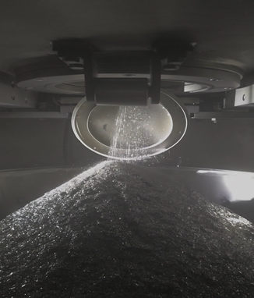
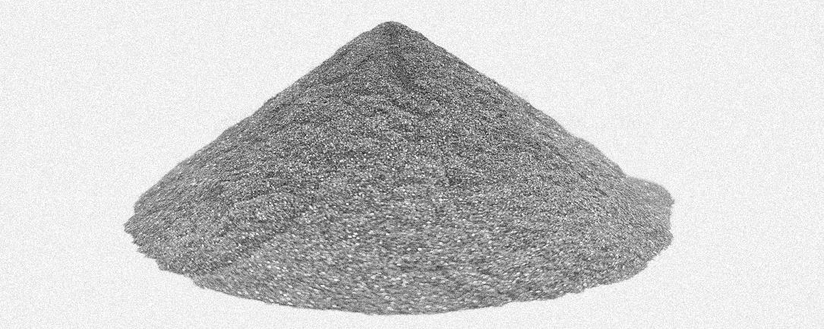
2. Industry Capacity and Market Structure
Key Equipment:
More than 50 rapid quenching furnaces
Capacity utilization rate
approximately 65%;
Capacity is relatively
overs-upplied.
Annual Capacity:
Approximately 23,000–24,000 tons
Actual output in 2025:
Approximately 15,000 tons

Slide 9
2. 行业产能与市场格局
2. Industry Capacity and Market Structure
Currently, the top three producers of magnetic powder are Magnequench (Tianjin) Co., Ltd., Chengdu Galaxy Magnets Co., Ltd., and Zhejiang Silver Sea Magnetics Co., Ltd., with their combined production accounting for 60–70% of the total fast quenching magnetic powder output.
Ranking | Company Names | Annual Production (Tons)
1 | Magnequench (Tianjin) Co., Ltd. | 5000-6000
2 | Chengdu Galaxy Magnets Co., Ltd. | Approximately 3000
3 | Dongyang Silver Sea Magnetics Co., Ltd. | Approximately 1200

Slide 10
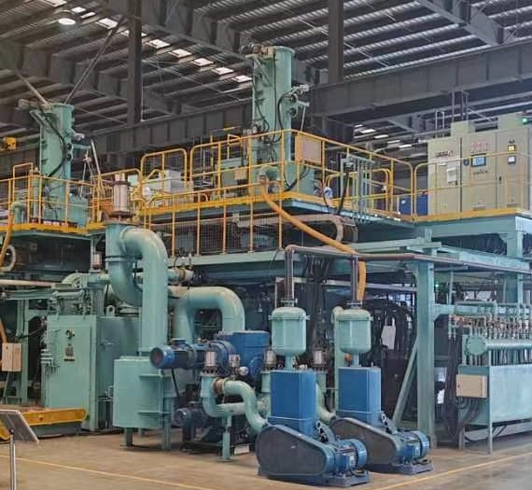
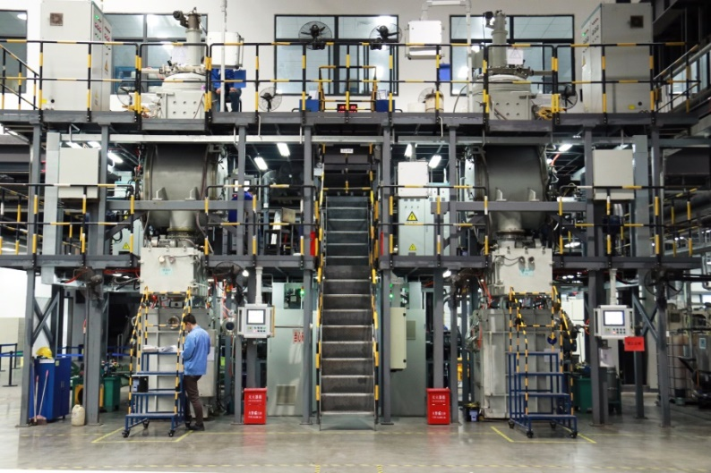
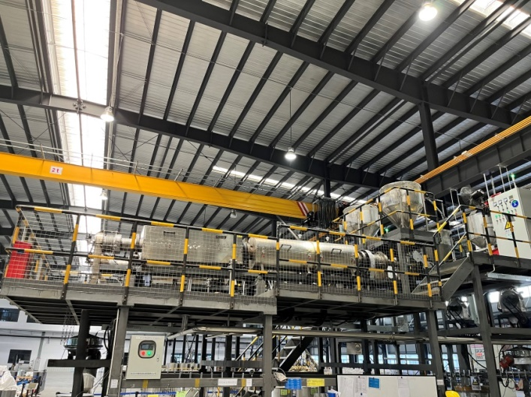
3. Production Equipment and Manufacturing Status
The primary equipment for magnetic powder production includes melting furnaces, rapid quenching furnaces, and crystallization furnaces. The crystal structure and magnetic properties of fast quenching magnetic powder are primarily determined by the fast quenching process, with the fast quenching furnace being the most critical equipment in the production of magnetic powder.
Melting Furnaces
Rapid Quenching Furnaces
Crystallization Furnaces

Slide 11
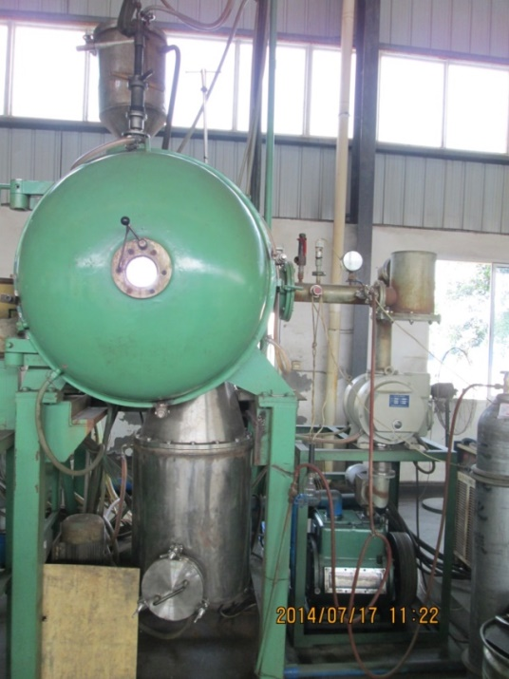
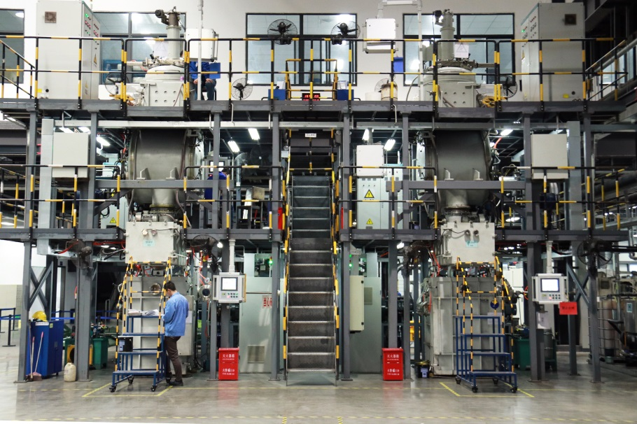
3. Production Equipment and Manufacturing Status
3. 生产装备与制造现状
Rapid Quenching Furnace: A Technical Upgrade from Arc Furnace to Induction Furnace
Since 2020, the production of rapidly quenched magnetic powder in China has rapidly transitioned from arc furnaces to induction furnaces. The magnetic powder produced by induction furnaces exhibits higher and more stable magnetic properties. The more than 50 rapid quenching furnaces mentioned earlier specifically refer to induction furnaces, excluding the arc furnaces that have been phased out.
Arc Rapid Quenching Furnace
Induction Rapid Quenching Furnace

Slide 12
3. Production Equipment and Manufacturing Status
3. 生产装备与制造现状
Rapid Quenching Furnace: A Technical Upgrade from Arc Furnace to Induction Furnace
Before 2020:
Induction rapid quenching furnace equipment had poor quality and high prices (approximately 6 million RMB per unit).
Long commissioning period: It typically required about two years of commissioning before the equipment could be put into normal operation, resulting in low production efficiency.
After 2020:
The quality of the equipment improved rapidly, and prices continued to decline. Currently, the price is generally around 3 to 4 million RMB per unit.
It is reported that some magnetic powder manufacturers self-manufacture rapid quenching furnaces, allowing them to control costs at over 2 million RMB per unit.

Slide 13
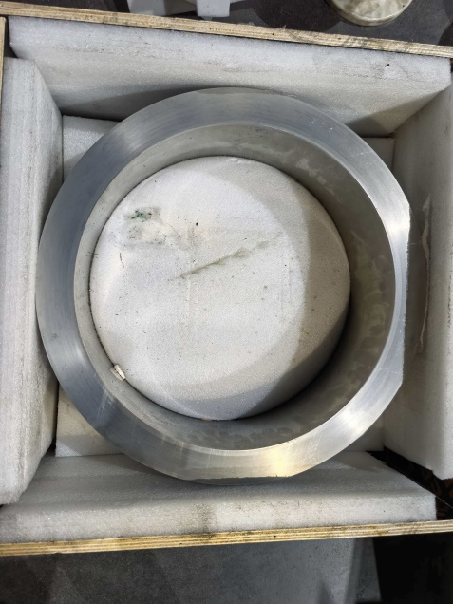
3. Production Equipment and Manufacturing Status
3. 生产装备与制造现状
Rapid Quenching Furnace: Core Consumables - Molybdenum Wheel or Alloy Wheel Domestically Produced
Originally imported consumables: Molybdenum wheel approximately 400,000 RMB per piece, alloy wheel approximately 900,000 RMB per piece;
Currently domestic alternatives: Domestic alloy wheel, price approximately 400,000 RMB per piece.
Significantly reduces the cost per ton of magnetic powder production, with domestic alloy wheels cutting production costs by approximately 1100 RMB per ton.

Slide 14
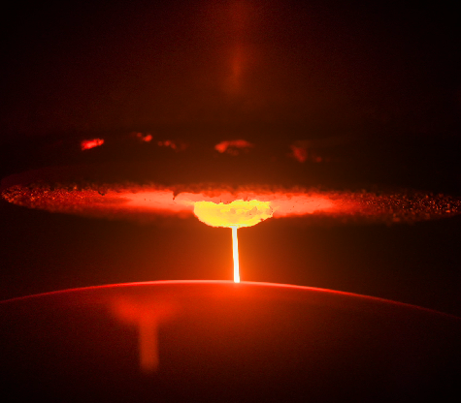
3. Production Equipment and Manufacturing Status
3. 生产装备与制造现状
Single Furnace Production Efficiency Improvement
The average production time per furnace for magnetic powder has increased from 30–40 hours two to three years ago to 60–70 hours currently, and it is still increasing. The longest single furnace production time has already exceeded 170 hours.
This has significantly reduced the production cost of magnetic powder.

Slide 15
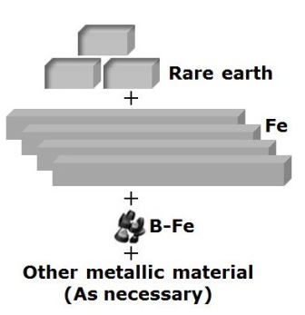
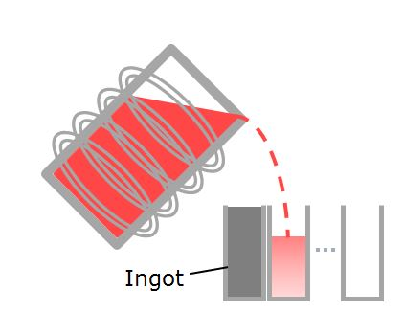
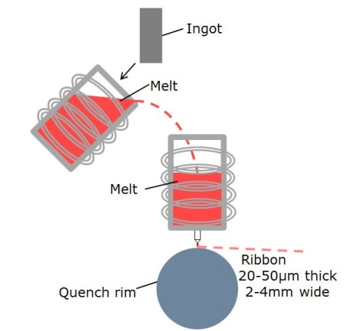
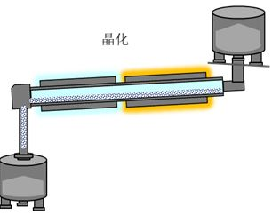
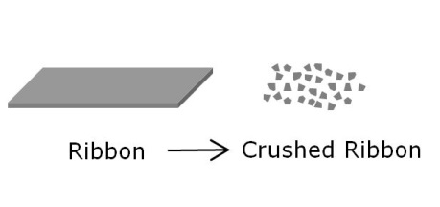
4. Core Process Optimization
This also significantly reduces the production cost of magnetic powder. Previously, before producing rapid quenching magnetic powder, various metals or alloys had to be melted into ingots first. Now, the process is mostly changed to “Direct Melting" ,where metals or alloys are melted and rapidly quenched into powder directly in the rapid quenching furnace, eliminating the melting step. This also substantially lowers the production cost of magnetic powder, reducing costs by approximately 1200 to 1500 RMB per ton.
Eliminating the melting process
Direct Melting in the Rapid Quenching Process

Slide 16
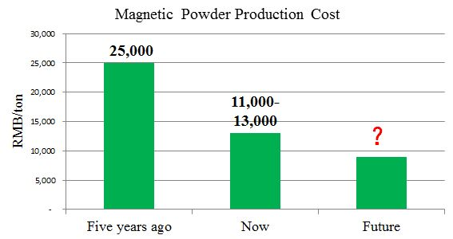
5. Trend of Magnetic Powder Production Cost Changes
Due to continuous improvements in equipment quality, the use of domestically produced alloy wheels, and process enhancements, the cost of producing one ton of magnetic powder has decreased from approximately 25,000 RMB five years ago to around 13,000 RMB currently. Some manufacturers may have already reduced it to as low as 11,000 RMB, and it is still continuously decreasing.

Slide 17
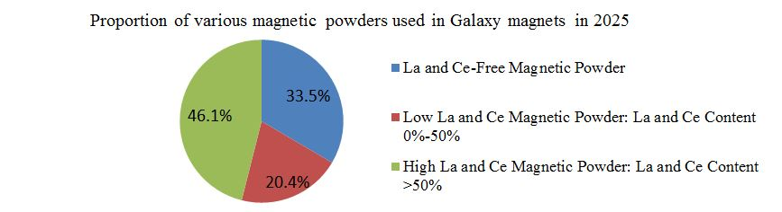
6. Diversification of Magnetic Powder Grades
Five years ago, the main rare earth components in magnetic powder were PrNd with a small amount of LaCe;
currently, the formula is adjusted based on the performance requirements of the magnet, with extensive use of cheaper LaCe to replace PrNd. In some magnetic powders, the PrNd content has dropped below 1 wt.%, leading to a significant reduction in production costs. Many magnets that should no longer be called bonded NdFeB should instead be referred to as LaCeFeB.

Slide 18
7. Competition and Development in the Magnetic Powder Market
Overall, the competition in the magnetic powder market is not as brutal or bloody as it might seem, but it is still extremely fierce. This is because the actual production capacity far exceeds market demand. To maximize the utilization of their equipment, manufacturers often engage in repeated price reductions, making it nearly impossible for any company to achieve good profits.
The automation and intelligence of the manufacturing process will continue to improve, further reducing costs, but it is unlikely to result in better profits.
Therefore, do not believe rumors, avoid blind investments, and prevent incurring losses.

Slide 19
7. Competition and Development in the Magnetic Powder Market
7. 磁粉市场的竞争和发展
Therefore, the future development of magnetic powder mainly depends on the application and promotion of bonded NdFeB magnets!
As people's pursuit of a better life continues to grow, the demand for micro-motors in industries such as automobiles and various household appliances will increase, naturally leading to more applications for bonded NdFeB magnets. It is believed that the demand for rapidly quenched NdFeB magnetic powder will also continue to rise due to the expansion of magnet applications.

Slide 20
Thanks！

